Slide 1
Sensor less toilet
With waste disposal system
PROJECT BY
TARUN RAJ GNANASEKARAN

Slide 2
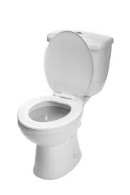
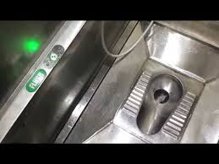
INTRODUCTION OF THIS PROJECT
Nowadays we’re using e-toilets in rural and urban environments providing sanitation solutions to people on the move. But especially we’re using toilet sheets and disposed freely in floor causes hygienic problems and creates an dissatisfied to use the toilets where in not maintaining clean. In this case we’re introducing sensor less toilets with waste disposal system for preventing this problems to deployed in public toilets, ensuring efficiency, sustainability, and user satisfaction.
PIC:1:2:1 WESTERN TOILET
PIC:1:2:2 E TOILETS

Slide 3
TECHNICAL APpROACH
This projects works based on the embedded system by using ATMEGA328 microcontroller motherboard in hardware and includes Embedded C programming in Arduino IDE software. and it contains five components that works in this system such as
PCB modified ATMEGA328 motherboard.
Solenoid valve for flushing purpose.
Solenoid lock for door locking purpose.
DC 12V LED (Red, Green) light for indication purpose.
Coin collecting machine for token purpose.
Vacuum pump system for disposal of toilet paper waste.
Calling bell switch for unlocking purpose fixed in inside.
ATMEGA328 MOTHERBOARD

Slide 4
TECHNICAL APpROACH
PIC:!:4:1 LED VACANCY INDICATOR
PIC:1:4:2 CALLING BELL SWITCH
PIC:1::4:3 COIN COLLECTING MACHINE WITH SOLENOID LOCK
PIC:1:4:4 SOLENOID WALVE
PIC:1:4:5 VACCUM PUMP

Slide 5
METHODOLOGY
SENSOR LESS TOILET:
In this system we have to inset a coin to the coin collecting machine and the solenoid lock was unlocked and the toilet is flushed for 1.5 seconds before use and when we go inside the toilet the solenoid lock will locked.
After using the toilet we unlock the door by using a calling bell switch for unlock the door and it will open.
In this flushing mechanism we’ve collected the real time data basis of a man using a toilet that we written a code for timing of the flushing based on two criteria
For using restroom : 1.5 seconds of flushing.
For using leviatory : 6 seconds of flushing.

Slide 6
mEthodology
WASTE DISPOSAL SYSTEM:
For we disposing the toilet sheets an container contains a vaccum pump for sucking the wastes and its get stored to the a collection chamber which is situated in outside of the toilet for better takeoff from that place.
In this case the calling bell switch also acts a vaccum pump system which it is written a code for 3 seconds with medium pressure to suck off.

Slide 7
Advantages
Water efficiency
Durability and maintenance
Cost effectiveness
User friendly
Hygiene and sanitation

Slide 8
THANK YOU

